Slide 1

DriverPass System Analysis
Cooper Adams
Notes:
[No speaker notes required for this slide.]

Slide 2

System Requirements
Functional:
The system shall provide students a platform to access their learning information and results
The system shall allow employee drivers to manually update their schedules
Non-Functional:
The front-end should be extremely responsive as it will be lightweight in build with the usage of JavaScript and other front-end languages
There will be unique roles in the system to differentiate between employees, customers, and admins
Notes:
Requirements were determined to make the system function efficiently. The functional requirements listed show how the system will cater to the user, be it a student or employee. Students come to DriverPass to learn, and the system will provide them a place to do so. Drivers will have a busy schedule, and will inevitably need to change it around, so the system gives them the ability to do so. The nonfunctional requirements detail parts of the system that aren’t visible on the surface. Responsiveness is everything when working online, so we want to ensure the user has as smooth of an experience as possible. Additionally, we want to ensure the correct people are accessing the correct content, so assigning roles and verifying them in real time will allow us to keep data where it should be.

Slide 3
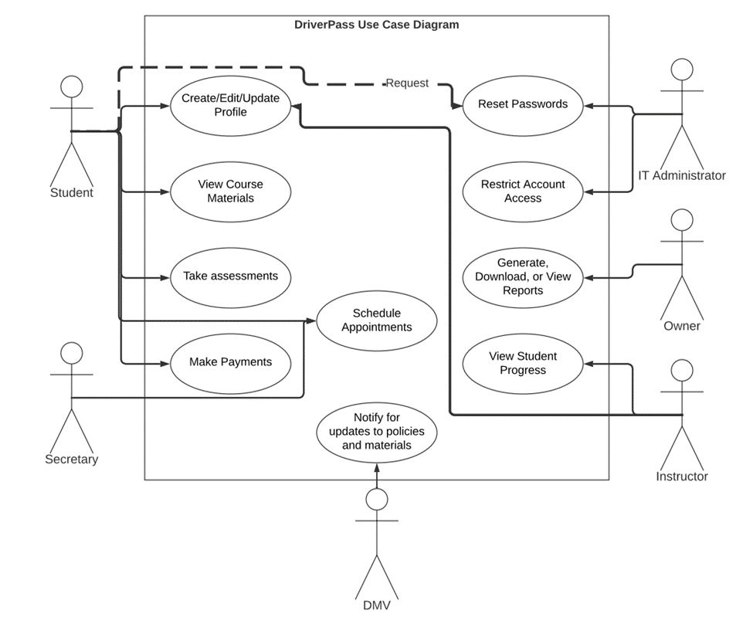
Use Case Diagram
Notes:
The use case diagram here details what will typically happen while the system is in use. Day to day, you will have students, employees, and potentially the DMV interacting with the system. Going from person to person in the diagram, we can see what everyone is able to do. Students can access their profile, coursework, appointments, and make payments. The IT Admin can reset passwords and restrict system access. The owner can work on reports. The secretary of course can schedule appointments for people, and the instructors are able to check in on their profiles and the students. The DMV will automatically provide us with updated information as well, so we won’t have to go out of our way to get it. All in all, the system covers the needs of everyone who would use it.

Slide 4
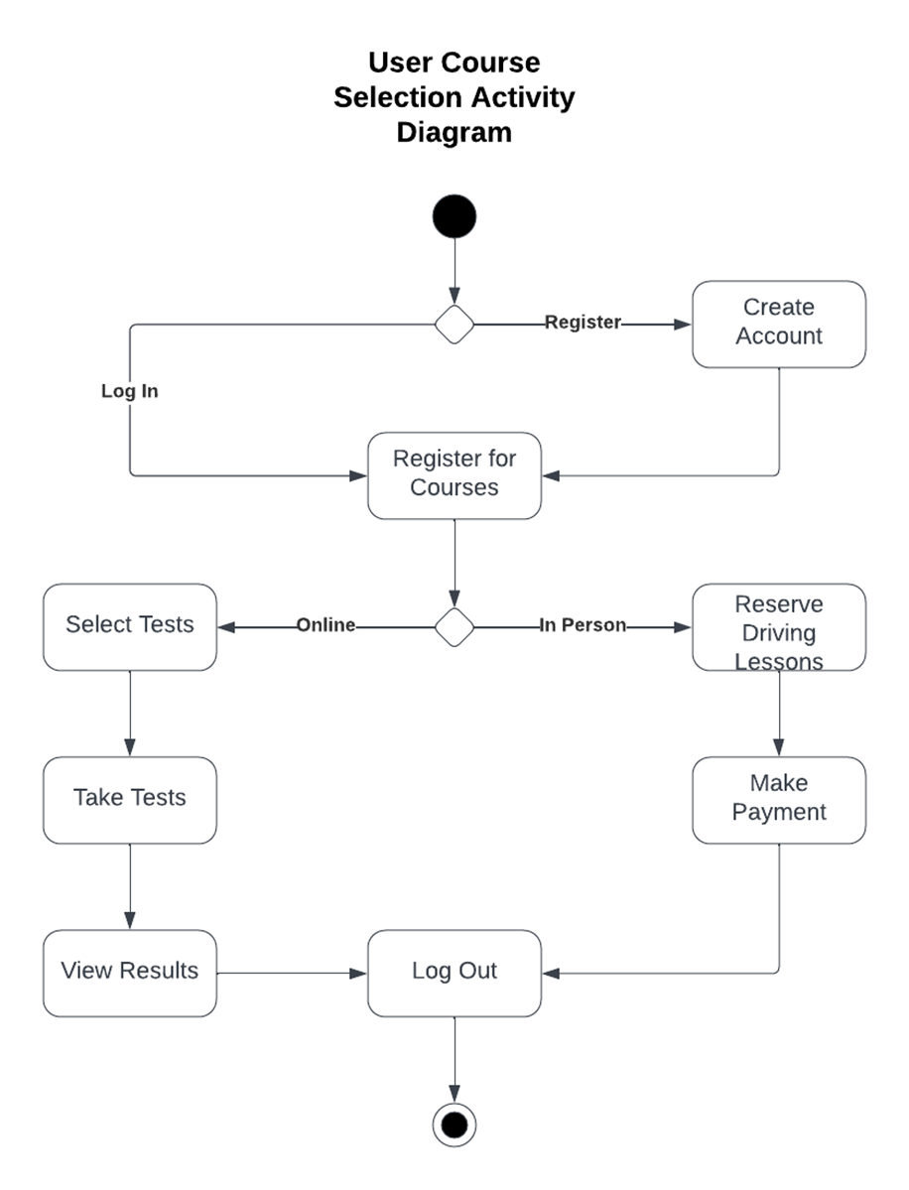
Activity Diagram
Notes:
This activity diagram breaks down what happens when a student selects a course to take. After registering or signing in, the student has the option to take tests online for free or schedule in person driving lessons, where the price varies depending on the package. I spoke about the system providing a platform for learning earlier, and this diagram details that. We are providing a platform that will help students online or set them up for in-person instruction, and this diagram displays the steps of exactly how it happens.

Slide 5
Security
System is hosted in AWS Cloud
Usernames and Passwords are unique and case sensitive
Consecutive failed log ins result in a password reset
All data transferal is encrypted
The IT Administrator will be able to remove potential security threats
Notes:
Security is easily the most important thing to consider when building this type of system. We have usernames, passwords, and money being sent back and forth through it, so keeping it secure was the top priority. Putting the system in the cloud ensures it can’t be tampered with physically and makes the data much harder to access for those with bad intentions. We also take basic measures with logins like case-sensitivity and uniqueness, which are known ways to easily improve account security. Failing to sign in three times will lock the account automatically, which prevents brute-force account hacking (explain brute-force hacking if needed, though it should be self explanatory). Of course, data sent to and from the system is encrypted, and we don’t need to know the details of how, but we do know that this will prevent the data from being stolen while it is moving. And of course, the IT Admin can handle potential threats by taking away system access from people who do not or no longer need it.

Slide 6
System Limitations
New instruction packages will require a developer to add
The system is web based, with no applications
Time for project completion was about 5 months
DriverPass has only 10 cars available at one time
Cloud storage is limited to DriverPass’s willingness to spend
Notes:
Every system will be limited in some form, and this one was no different. DriverPass will not be able to add potential new instruction packages without the help of a developer, as they only provided a few packages to start with and no future plans to keep in mind. The system itself is in the cloud, but we will use it in a web browser, whether that’s on a computer or a mobile device. Creating an app was not within the project scope and could limit the accessibility for some people. The project was completed in about 5 months, which may mean there is room for more testing and refinement of the system. Currently DriverPass has 10 cars of varying make and model, which could be a problem if the demand for in person instruction is high. And, any data that is stored or processed by this system will be done in the cloud, which is typically priced in large chunks. If the space needed for the system’s data continues to grow, DriverPass will have to explore paying for more storage space.

